Slide 1

Lesson 8:
Integrals

Slide 2


Introduction

Slide 3

Lecture Overview:
Goals of the lecture:
Understand the anti-derivatives (Integral) and its properties

Slide 4
Integrals

Slide 5
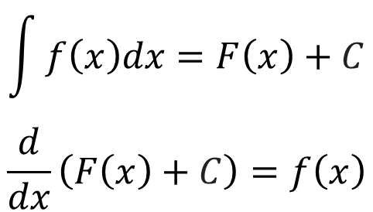
Indefinite Integrals
Definition:
Indefinite integrals are the anti-derivatives
$$\int{f\left(x\right)dx=F\left(x\right)+C}$$
$$\frac{d}{dx}\left(F\left(x\right)+C\right)=f\left(x\right)$$

Slide 6
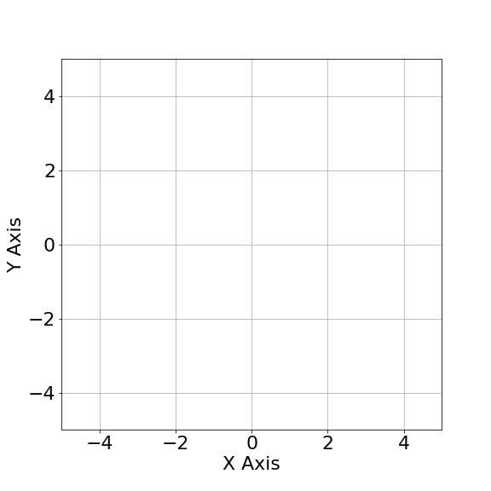
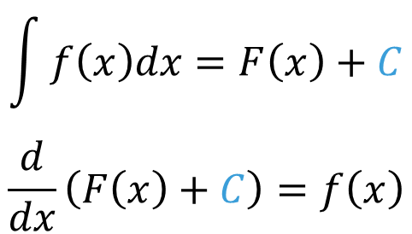
Constant C
Definition:
Indefinite integrals are the anti-derivatives
$$\int{f\left(x\right)dx=F\left(x\right)+C}$$
$$\frac{d}{dx}\left(F\left(x\right)+C\right)=f\left(x\right)$$

Slide 7
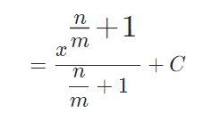
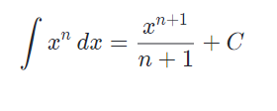

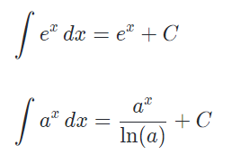

Integrals (Cheat Sheet)
Polynomials
Radicals
Exponentials
Logarithms

Slide 8
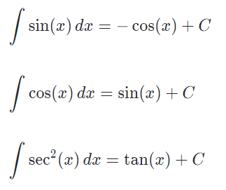
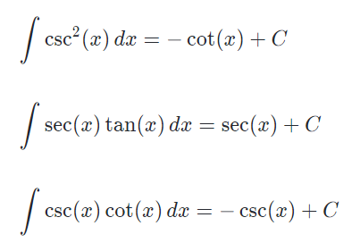
Integrals (Cheat Sheet)
Trigonometric

Slide 9
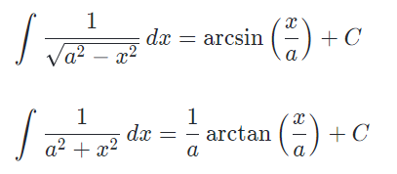
Integrals (Cheat Sheet)
Inverse Trigonometric

Slide 10
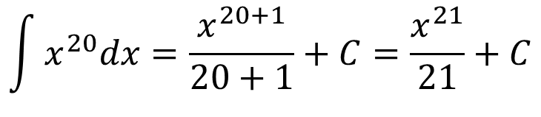
Example: Indefinite Integrals
$$\int{x^{20}dx=\frac{x^{20+1}}{20+1}+C=\frac{x^{21}}{21}+C}$$

Slide 11
Rules for Integrals

Slide 12
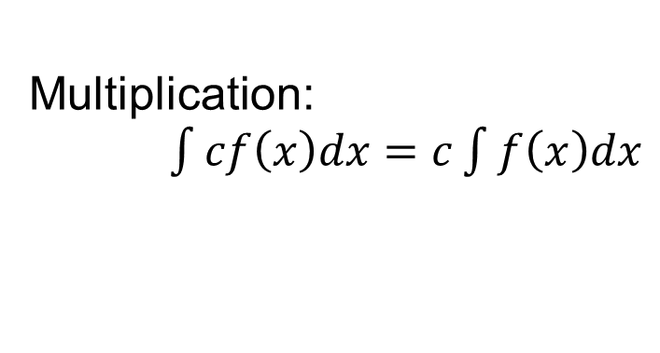
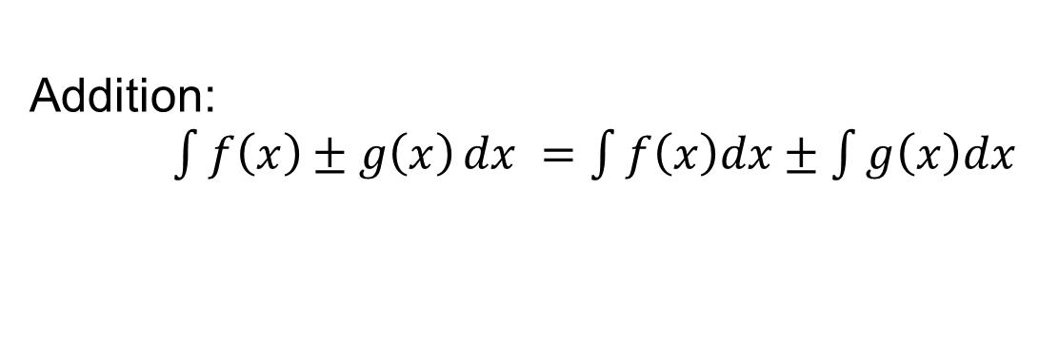
Rules for Integrals
Definition:
Addition:
$\int{f\left(x\right)±g\left(x\right)}dx =\int{f\left(x\right)dx±\int{g\left(x\right)dx}}$
Multiplication:
$\int{cf\left(x\right)dx}=c\int{f\left(x\right)dx}$

Slide 13
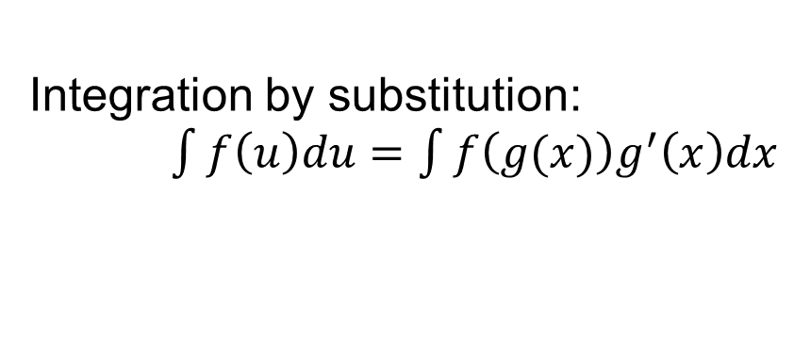
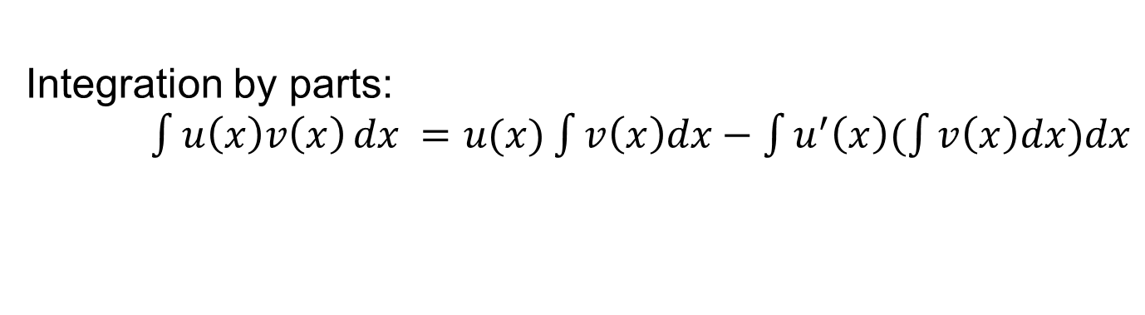
Rules for Integrals (Advanced)
Definition:
Integration by parts:
$\int{u\left(x\right)v\left(x\right)}dx =u(x)\int{v\left(x\right)dx−\int{u^{′}\left(x\right)(\int{v\left(x\right)dx})dx}}$
Integration by substitution:
$\int{f\left(u\right)du}=\int{f\left(g(x)\right)g^{′}\left(x\right)dx}$

Slide 14
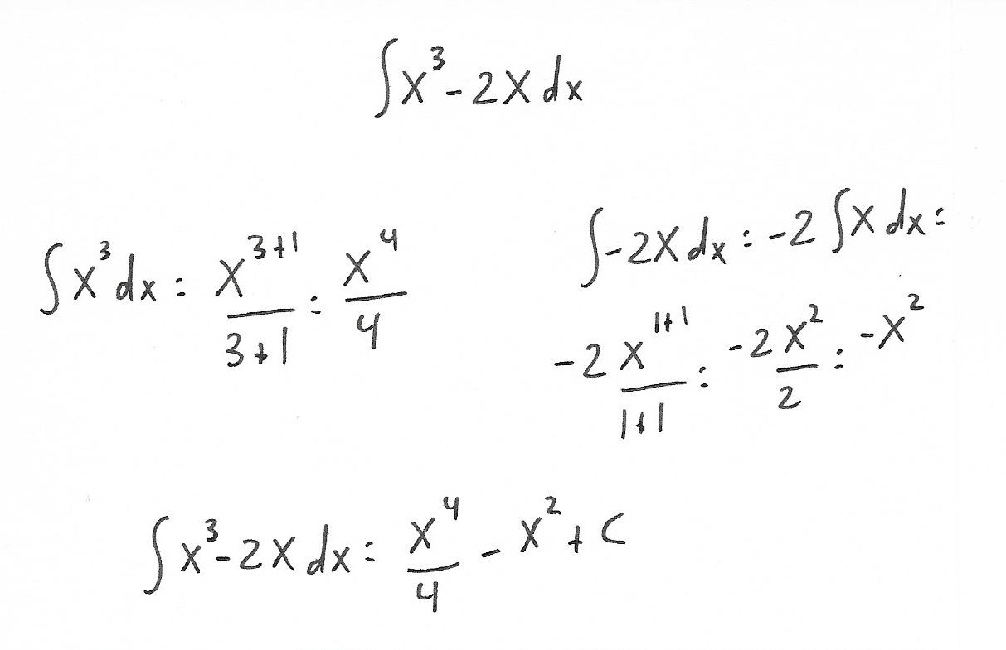
Problem 1:
Problem 1: Calculate the integral.

Slide 15
Problem 1:
Problem 1: Calculate the integral.

Slide 16
QUESTIONS?

